Slide 1
IMS Project
Hamza shah

Slide 2
Who am i?
Hamza Shah
BA Finance and Economics Graduate – University Of Hertfordshire
QA Trainee – 21SEPTSOFT pathway
Passion for cars and modifying cars.
Man U fan

Slide 3
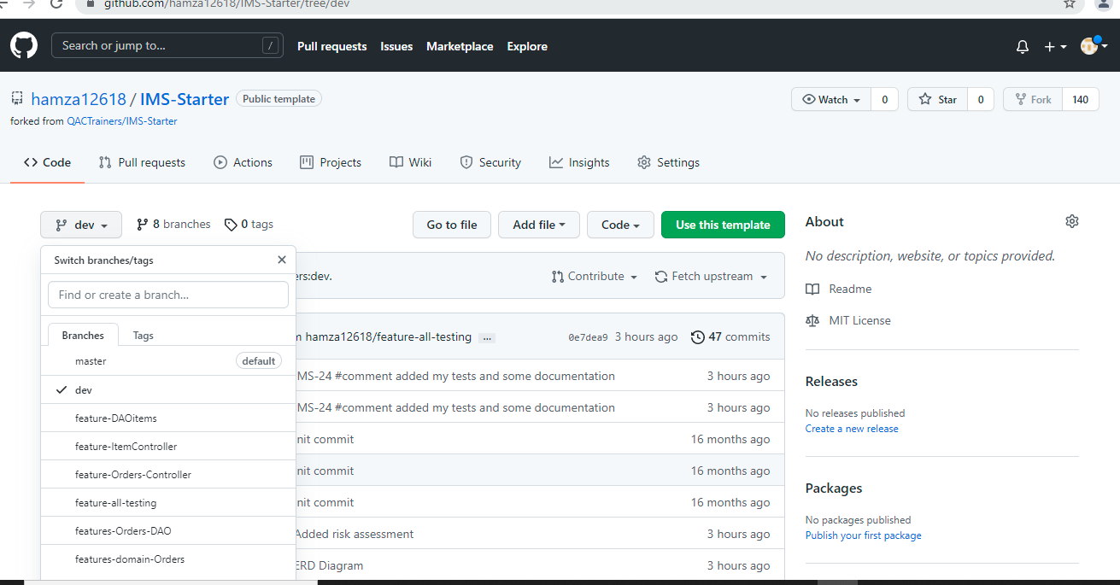
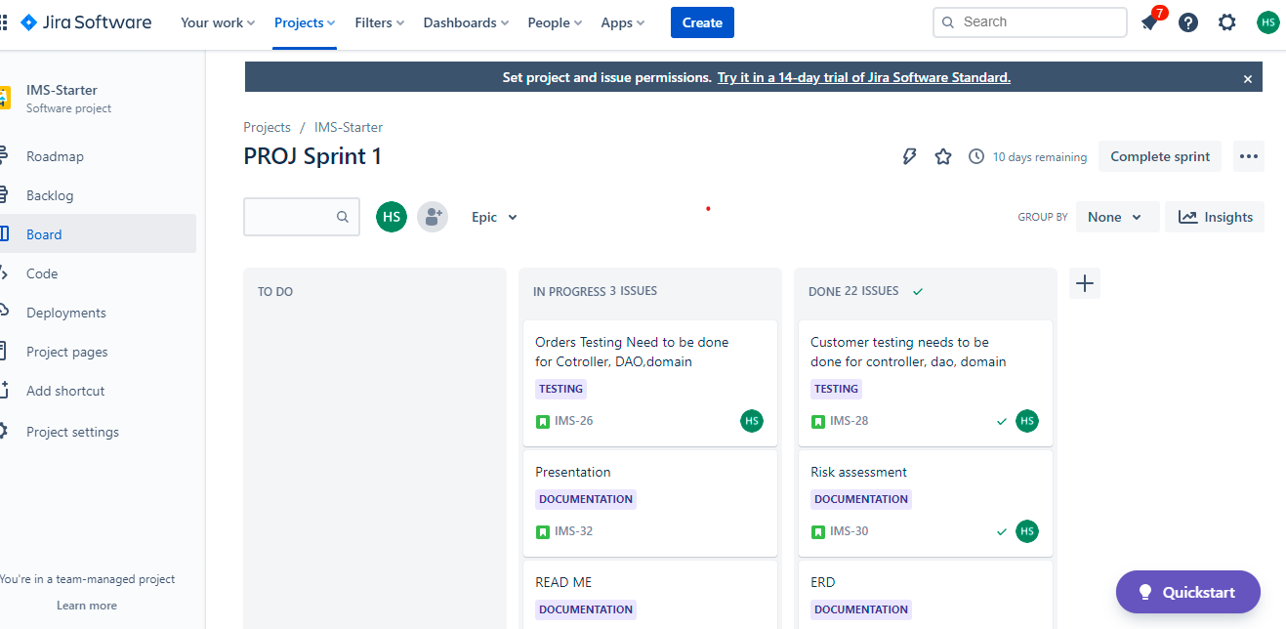
How Did I approach the specification
I started with thoroughly reading through the specification and planning which technologies I needed to use.
Then made a note of the requirements that are being assessed and what the actual project is asking me to do. Created a Kanbad board on Jira with epics and user stories where I assigned myself the tasks as well as ranking them on how long they will take me.
Initialised a ERD diagram for my SQL tables and gave them attributes as well as linked my primary keys + foreign keys. Next created my tables in SQL and began the code within eclipse.

Slide 4
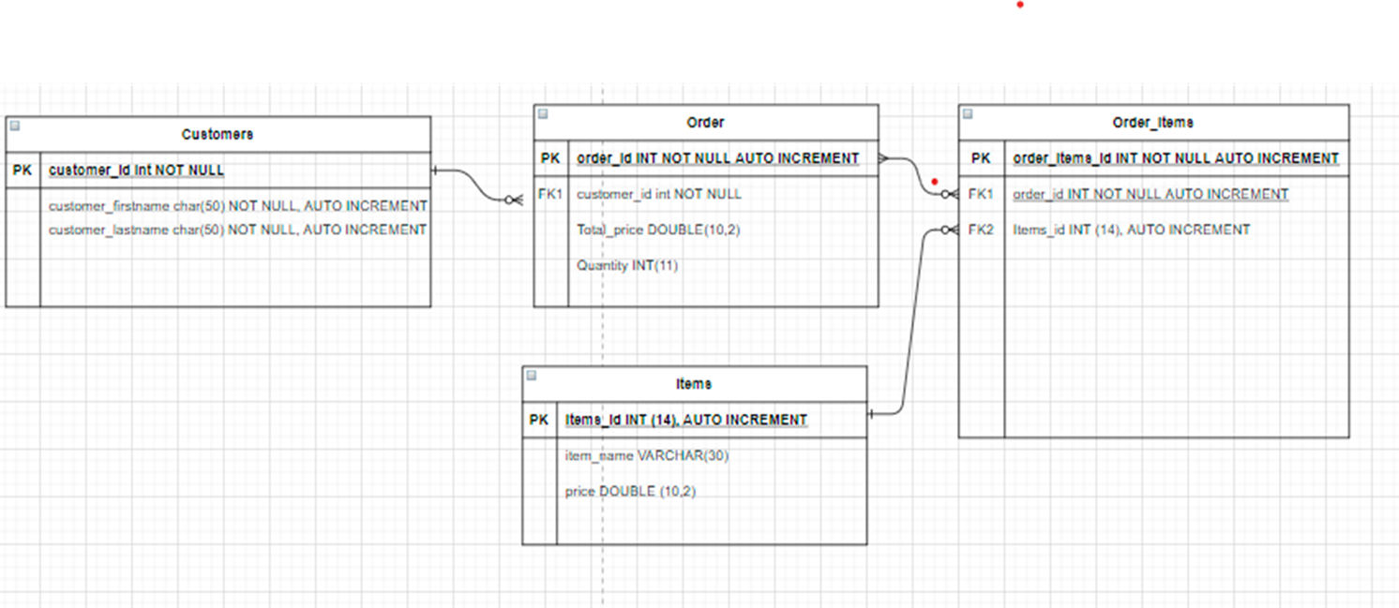
ERD Diagram

Slide 5
Consultant Journey
What technologies have you learned for this project?
Version Control System: Git To pull push and create branches
Source Code Management: GitHub On my repository
Kanban Board: Jira to plan my project and track progress as well as creating epics and user storing
Database Management System: MySQL Server 5.7+ (local or GCP instance) to create a database
Back-End Programming Language: Java on eclipse
Build Tool: Maven
Unit Testing: Junit for testing

Slide 6
CI: How did you approach version control?
GitHub: Issues, feature/branches, pull requests, push requests, merging feature branches into dev.
I used GitHub as my version control to keep my project on the cloud throughout the sprint making sure I create different feature branches for every different class I work on and merging them into my dev branch without having merge conflicts. I then committed my changes on the project and pulled them into my dev branch by merging them on git hub. This was very helpful in keeping my project in order and helping me keep track of what progress I’ve been making through the sprint.

Slide 7
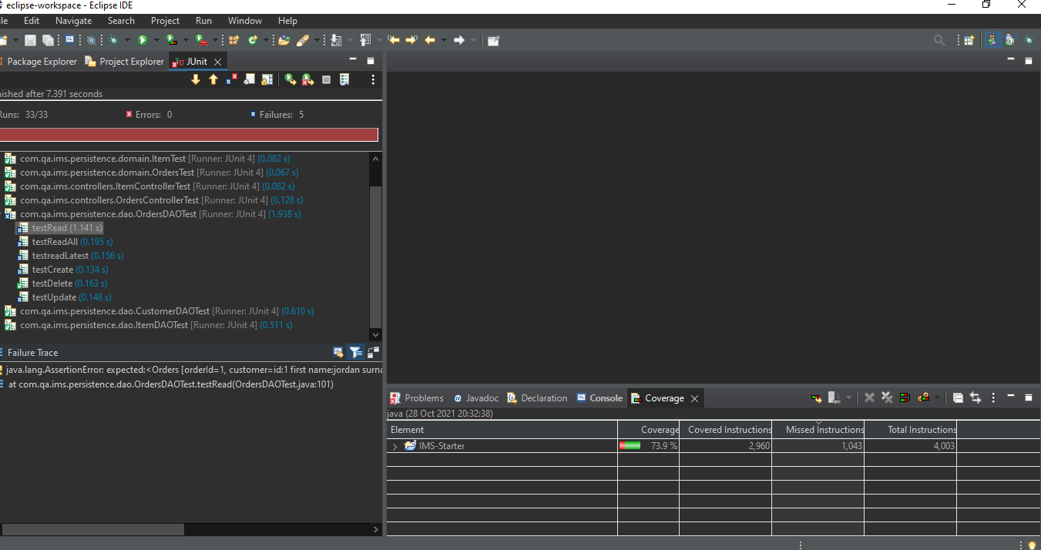
Testing: What was tested? Show the coverage of the src/main/java folder.
I had created 9 tests in total –
Domain classes - CustomerTest.java, ItemTest.java, OrdersTest.java
DAO classes - CustomerDAOTest.java, ItemDAOTest.java. OrdersDAOTest.java
Controllers classes – CustomerControllerTest.java, ItemControllerTest.java, OrdersControllerTest.java
All 8/9 tests have passed with a coverage of 73.9%, the target was 80%. The OrdersDAOTest.java has partially failed which I'm still in the process of debugging and hopefully will fix the bugs in time for submission to achieve the 80% coverage.
I had also done manual testing for all my SQL statements which passed with flying colours.

Slide 8
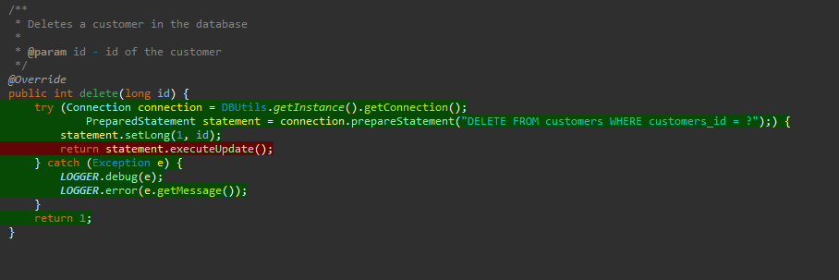
Demonstration: Run through a couple of user stories
I had 4 epics within the Sprint - Domain, Items, Orders, Testing and Documentation. Within these epics there were many user stories to fulfil the requirements of the specification.
Example User Story1: As a User I would like to delete customers so I can keep my database organised and remove non-existing customers.
This was a very important user story for the IMS project as it is part of the CRUD functionalities which had to be met. Also in a business function you need to be able to delete customers, items and orders in any database or program.
Code is from my CustomerDAO.java file

Slide 9
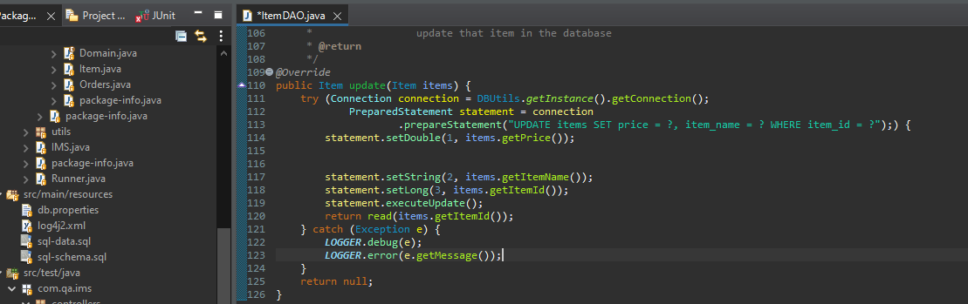
Example User story2: As a User I'd like to update my Items so i can change the products on sale
This User story is also part of the CRUD functions where the user would like to update items on sale for their business.
If a software did not allow these basic CRUD functions for a database model it would be non-existent. Similarly to the previous User story this is also very important to update items and businesses to update new items regularly some items can also be removed and price changes due to inflation must be easy to manipulate on the database.

Slide 10
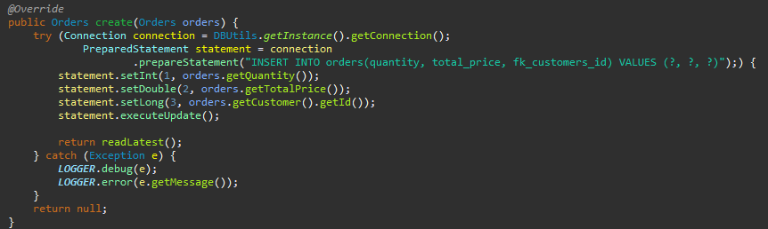
Example user story3: As a User I'd like to add a item to an order so i can create customer orders
This is part of the CREATE function within the CRUD and is important as all the other CRUD functions. As a user its really vital for the program to be able to create orders with items inside so there business can operate. The code below is from my OrdersDAO.java class

Slide 11
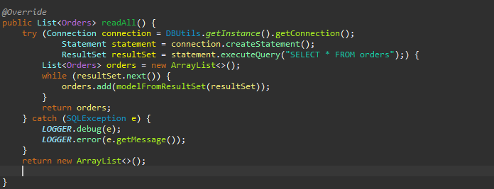
Example user story4: As a User I'd like to view all orders so i can analyse my orders and make sure they are correct
This is the final CRUD function Read where users would like to view all orders and analyse them.

Slide 12
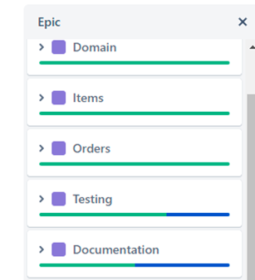
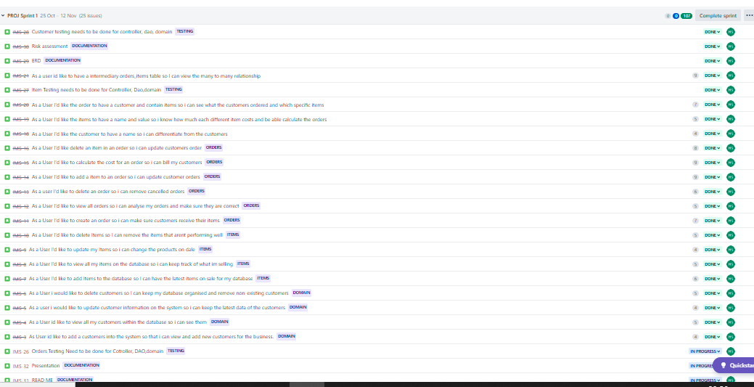

Slide 13
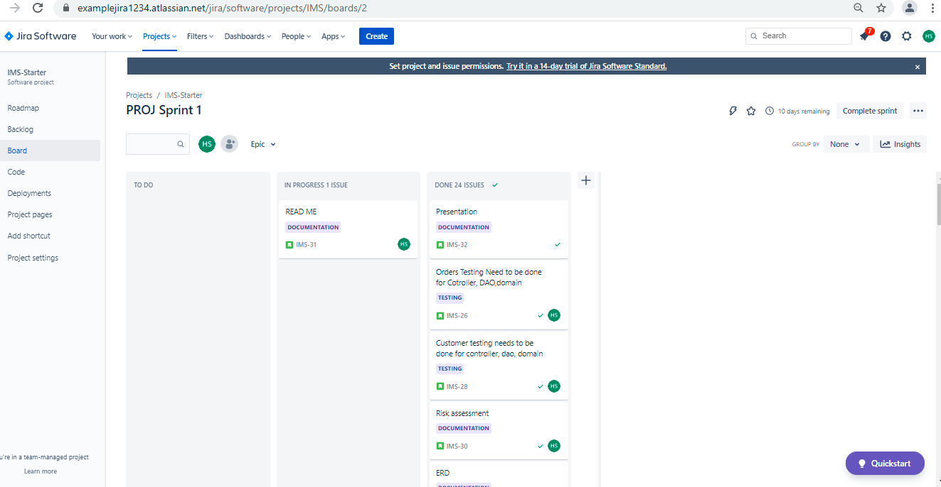
Sprint review: What did you complete? What got left behind?
I have completed all my user stories on Jira for my epics which you can see on my Jira board except my Readme file and OrderDAOTest which I will be completing after my presentation. As you can see below 24 issues have been completed and one in progress.
I also struggled with my calculator class which got left behind.

Slide 14

Sprint retrospective: What went well? What could be improved?
Overall the project went well learnt many things on the way and debugging was actually fun. Completed the checklist and lived up to the specification requirements in my personal opinion. However, there would be a few changes I’d make if I was to repeat the project. I’d check after every class I make to check my SQL statements are matching with SQL tables that way I don’t have any errors when doing manual testing and Junit testing.
Although I planned my approach and structure of completing tasks I would still improve it by creating a contingency plan. This Is because when I was debugging my errors it got time consuming and I should’ve gone to the next task and come back to it rather than bashing my head debugging.

Slide 15
Conclusion: Reflections on the project, future steps, any other relevant info
As a whole this project was very engaging and fun to complete as I encountered many debugging opportunities which boosted my confidence. Future steps and precautions I will take would be to make sure small spelling errors are avoided and the fact that my SQL statements are matching with the table content I initially created.
Thanks for listeing!

